Slide 1
Constructing pie charts by utilising technology
Graphical representations of data

Slide 2
how to use Oak lessons

Slide 3
I can construct pie charts from data presented in a number of different ways using technology.

Slide 4
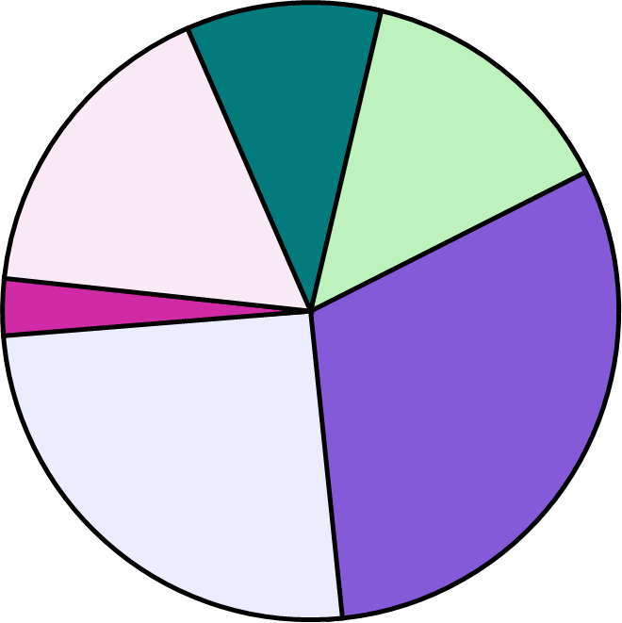
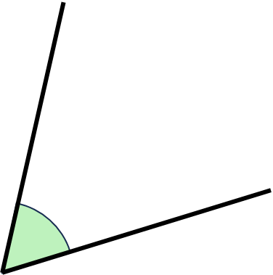
Clockwise is the direction that the hands of an analogue
clock travel.
A pie chart (pie graph) is a circular graph where sectors represent different groups proportionally.
The frequency is the number of times an event occurs; or the number of individuals (people, animals etc.) with some specific property.
An angle is a measure of turn, it is often displayed as the rotation between two line segments.
angle
A sector is the region formed between two radii and their connecting arc.

Slide 5

Constructing pie charts by utilising technology
Using spreadsheet functions to calculate angles
Constructing pie charts using spreadsheets

Slide 6
Using spreadsheet functions to calculate angles
This lesson will cover the use of spreadsheets in:
Google Sheets
Microsoft Excel
Other spreadsheet software is available, and a lot of the functionality taught in this lesson will be transferable.

Slide 7
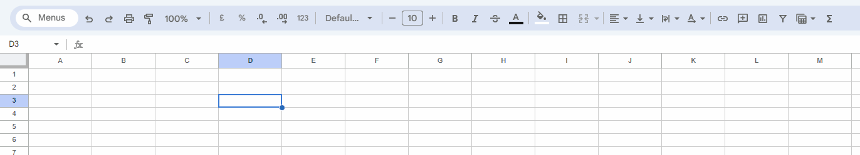
Using spreadsheet functions to calculate angles
Basic features of a spreadsheet
Insert Chart
Cell Name
Insert Function
Cell
Google Sheets is a trademark of Google LLC and this content is not endorsed by or affiliated with Google in any way.

Slide 8
Using spreadsheet functions to calculate angles
We will be using spreadsheets to perform and update calculations to help convert frequency data into angles to plot onto a pie chart.
When asking a spreadsheet to perform any mathematical calculation, you must always type the equals symbol into the cell first.
=

Slide 9
Using spreadsheet functions to calculate angles
On your keyboard, there are buttons for each of the four basic operations:
addition +
subtraction -
multiplication *
division /
Please note that you cannot multiply by using the letter x.
Most of these are found on the top row of your keyboard (where the numbers are), and accessed using the shift-key.
The division / is on the bottom-right of the keyboard.

Slide 10
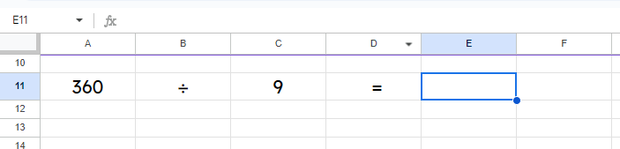
Using spreadsheet functions to calculate angles
I want to type in the answer to this maths question in the cell E11.
cell E11 zoomed in
=
A11
1) Click on the cell E11. You can check you have the correct cell by looking at the top left.
2) Press = to start a mathematical calculation.
3) Click on the cell with the first number you want to use in your calculation. In this question, click on cell A11, which contains the number 360.
Google Sheets is a trademark of Google LLC and this content is not endorsed by or affiliated with Google in any way.

Slide 11
Using spreadsheet functions to calculate angles
I want to type in the answer to this maths question in the cell E11.
cell E11 zoomed in
40
=
40
A11
/
C11
4) Notice how your calculation shows the cell number A11, not the number 360. This is correct.
5) We want to divide, so on your keyboard, press the / button.
6) Click cell C11, the cell containing the second number in your calculation.
7) Press enter to complete your calculation.
Google Sheets is a trademark of Google LLC and this content is not endorsed by or affiliated with Google in any way.

Slide 12
Using spreadsheet functions to calculate angles
Which button must you always press first on your keyboard to start a mathematical calculation?
=

Slide 13
Using spreadsheet functions to calculate angles
Match the operations to the keyboard symbols.
There are some incorrect options.
-
x
/
div
*
+
^
Addition
Multiplication
Subtraction
Division

Slide 14
Using spreadsheet functions to calculate angles
Match the operations to the keyboard symbols.
There are some incorrect options.
-
x
/
div
* +
^
Addition +
Multiplication *
Subtraction -
Division /

Slide 15
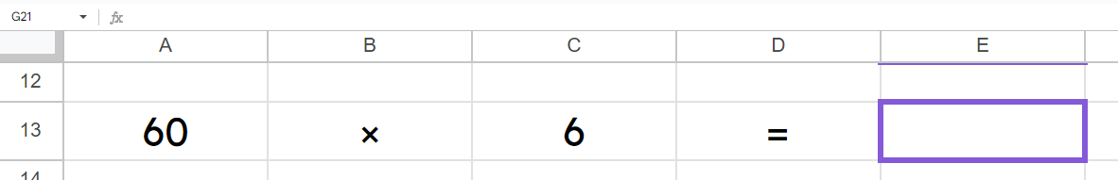


Using spreadsheet functions to calculate angles
I want to calculate the answer to this multiplication in the cell E13.
Which of the following is the correct input into this cell?
a
= 60 + 6
a
= 60 x 6
b
= A13 x C13
b
= A13 * C13
Google Sheets is a trademark of Google LLC and this content is not endorsed by or affiliated with Google in any way.

Slide 16
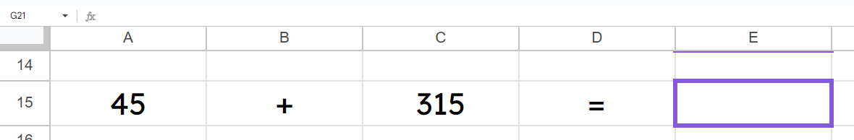
Using spreadsheet functions to calculate angles
I want to calculate the answer to this addition in the cell E15.
Fix the one mistake in the formula in E15.
= A15 + B15
= A15 + C15
Google Sheets is a trademark of Google LLC and this content is not endorsed by or affiliated with Google in any way.

Slide 17
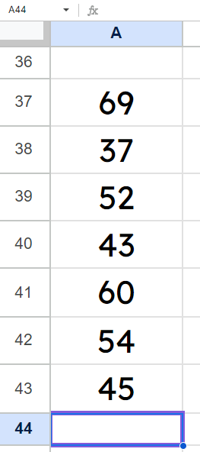
Using spreadsheet functions to calculate angles
It is very easy to add together large lists of numbers.
Click in the cell you want to have the total and type in:
=sum(
Then click, hold, and drag to select all the cells you want to add together.
Type the close bracket ), and press enter to perform your calculation.
=sum(
A37:A43
)
360
Google Sheets is a trademark of Google LLC and this content is not endorsed by or affiliated with Google in any way.

Slide 18
Using spreadsheet functions to calculate angles
What two things are incorrect about this sum function?
=sum A54 ; A56)
There should be a bracket after the word sum.
This should be a colon :
Not a semi-colon ;
=sum(A54 : A56)

Slide 19
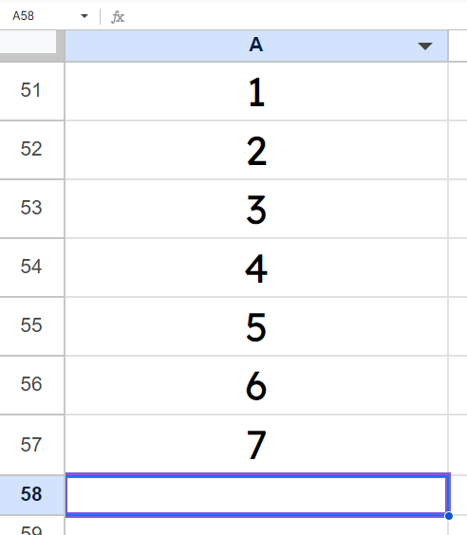
Using spreadsheet functions to calculate angles
What would be the answer to this calculation?
Be careful about which cells are included in the function.
=sum(A54 : A56)
4 + 5 + 6 = 15
Google Sheets is a trademark of Google LLC and this content is not endorsed by or affiliated with Google in any way.

Slide 20
Using spreadsheet functions to calculate angles
Calculating angles for a pie chart
 | B | C | D
6 | Year Group | Frequency | Angle
7 | Year 7 | 42
8 | Year 8 | 36
9 | Year 9 | 36
10 | Year 10 | 30
11 | Year 11 | 48
12
13
14 | multiplier
A teacher collected data showing the number of students from each year group who attended homework club last week.
The teacher wants to represent this data as a pie chart using spreadsheets.
Google Sheets is a trademark of Google LLC and this content is not endorsed by or affiliated with Google in any way.

Slide 21
Using spreadsheet functions to calculate angles
Calculating angles for a pie chart
 | B | C | D
6 | Year Group | Frequency | Angle
7 | Year 7 | 42
8 | Year 8 | 36
9 | Year 9 | 36
10 | Year 10 | 30
11 | Year 11 | 48
12
13
14 | multiplier
1) Calculate the total frequency
Select the cell underneath all the frequencies.
Type in =sum(
Then click, hold, and drag to select all the frequencies, and press the close bracket button ).
=sum(
192
total
C7:C11)
Press enter.
Google Sheets is a trademark of Google LLC and this content is not endorsed by or affiliated with Google in any way.

Slide 22
Using spreadsheet functions to calculate angles
Calculating angles for a pie chart
 | B | C | D
6 | Year Group | Frequency | Angle
7 | Year 7 | 42
8 | Year 8 | 36
9 | Year 9 | 36
10 | Year 10 | 30
11 | Year 11 | 48
12
13
14 | multiplier
2) To calculate the multiplier that links frequency to angle, you must divide 360 by the total frequency.
Select the cell to the right of “multiplier”.
Type in = 360 /
total
192
Select the cell with the total frequency.
= 360 /
1.875
C12
Press enter.
Google Sheets is a trademark of Google LLC and this content is not endorsed by or affiliated with Google in any way.

Slide 23
Using spreadsheet functions to calculate angles
Calculating angles for a pie chart
 | B | C | D
6 | Year Group | Frequency | Angle
7 | Year 7 | 42
8 | Year 8 | 36
9 | Year 9 | 36
10 | Year 10 | 30
11 | Year 11 | 48
12
13
14 | multiplier
3) The value of the “multiplier” can be multiplied by a frequency to calculate the angle needed for the pie chart.
=
C7
*
Select a cell in the angle column
Type in =
Then select the frequency cell to the left.
total
Type in * to multiply
1.875
Google Sheets is a trademark of Google LLC and this content is not endorsed by or affiliated with Google in any way.

Slide 24
Using spreadsheet functions to calculate angles
Calculating angles for a pie chart
 | B | C | D
6 | Year Group | Frequency | Angle
7 | Year 7 | 42
8 | Year 8 | 36
9 | Year 9 | 36
10 | Year 10 | 30
11 | Year 11 | 48
12
13
14 | multiplier
3) The value of the “multiplier” can be multiplied by a frequency to calculate the angle needed for the pie chart.
78.75
=
C7
*
D11
Then select the cell with the value of the angle for the multiplier.
Press enter.
total
1.875
Google Sheets is a trademark of Google LLC and this content is not endorsed by or affiliated with Google in any way.

Slide 25
Using spreadsheet functions to calculate angles
Calculating angles for a pie chart
 | B | C | D
6 | Year Group | Frequency | Angle
7 | Year 7 | 42
8 | Year 8 | 36
9 | Year 9 | 36
10 | Year 10 | 30
11 | Year 11 | 48
12
13
14 | multiplier
4) Do the previous step for all groups.
In this example, calculate the angle for all five year groups.
78.75
67.5
67.5
65.25
5) These are all your angles.
To check you are correct, go to the cell underneath and use =sum( to add together all the angles above. The total should always be 360°.
90
total
=sum(D7:D11)
360
1.875
Google Sheets is a trademark of Google LLC and this content is not endorsed by or affiliated with Google in any way.

Slide 26
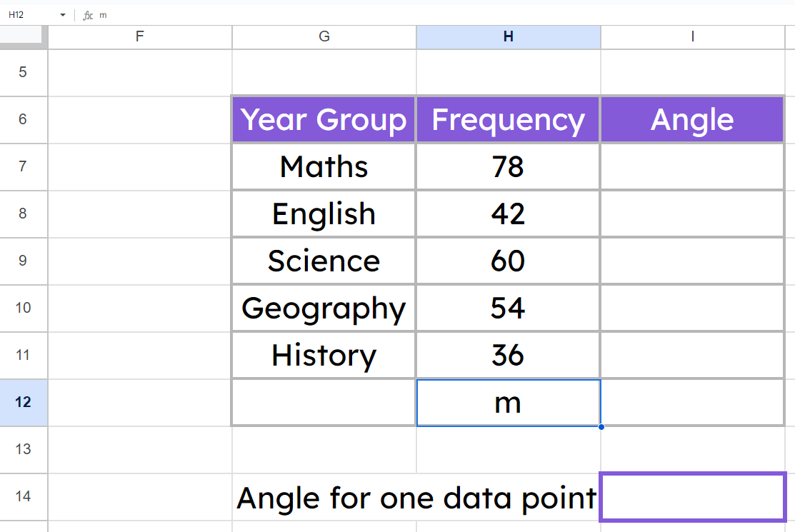
Using spreadsheet functions to calculate angles
Which of these functions is correct for the cell marked m?
a
sum(H7:H11)
Subject
b
= 360 / H12
c
= sum(H7:H11)
d
= sum(I1:I6)
multiplier
Google Sheets is a trademark of Google LLC and this content is not endorsed by or affiliated with Google in any way.

Slide 27
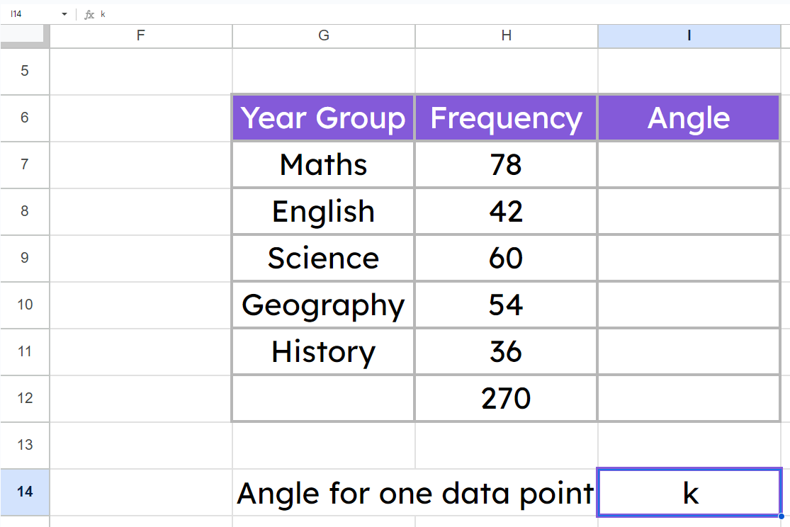
Using spreadsheet functions to calculate angles
Which of these functions is correct for the cell marked k?
a
= H12 / 360
Subject
b
= 360 / H12
c
= H12 * H7
d
= sum(I1:I6)
multiplier
Google Sheets is a trademark of Google LLC and this content is not endorsed by or affiliated with Google in any way.

Slide 28
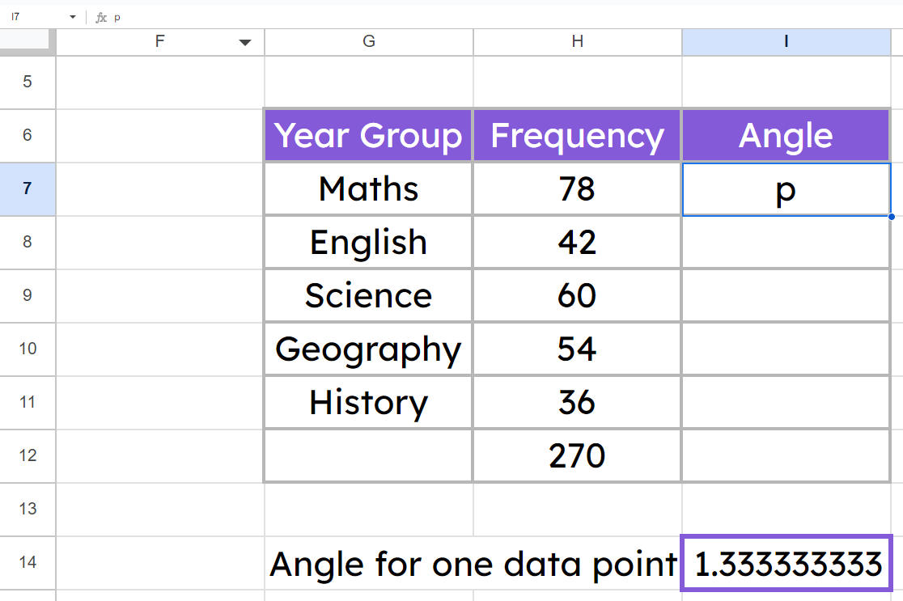
Using spreadsheet functions to calculate angles
Which of these functions is correct for the cell marked p?
a
= H7 / I14
Subject
b
= I14 / H7
c
= H12 * H7
d
= I14 * H7
multiplier
Google Sheets is a trademark of Google LLC and this content is not endorsed by or affiliated with Google in any way.

Slide 29
Using spreadsheet functions to calculate angles
Task A 🖇
Go to File → Make a copy to create your own copy to use.
1) To practise basic spreadsheet functions, complete the questions on the sheet called Practising functions.
2) To practise calculating angles for a pie chart, complete the questions on the sheet called Calculating angles.
Google Sheets is a trademark of Google LLC and this content is not endorsed by or affiliated with Google in any way.

Slide 30
Using spreadsheet functions to calculate angles
Task A Answers 🖇
The link will let you view all the answers to the practice tasks.
Google Sheets is a trademark of Google LLC and this content is not endorsed by or affiliated with Google in any way.

Slide 31
Constructing pie charts by utilising technology
Using spreadsheet functions to calculate angles
Constructing pie charts using spreadsheets

Slide 32
Constructing pie charts using spreadsheets
There are options in spreadsheet software that create pie charts for you.
We will create a pie chart from the table to the right.
Copy and paste this table into Microsoft Excel, or use this LINK 🖇 to use a Google Sheets copy.
You may also use the Google Sheets document accessed earlier in the lesson.
Year Group | Frequency | Angle
Year 7 | 8 | 21
Year 8 | 20 | 53
Year 9 | 33 | 87
Year 10 | 61 | 162
Year 11 | 14 | 37
total | 136 | 360
Microsoft Excel - Used with permission from Microsoft. Google Sheets is a trademark of Google LLC and this content is not endorsed by or affiliated with Google in any way.

Slide 33

Constructing pie charts using spreadsheets
Click, hold, and drag to select the year groups and the frequencies.
Do not select the total frequency row or the angles column.
Year Group | Frequency | Angle
Year 7 | 8 | 21
Year 8 | 20 | 53
Year 9 | 33 | 87
Year 10 | 61 | 162
Year 11 | 14 | 37
Total Frequency | 136 | 360
In Google Sheets, find the Insert chart button on the main toolbar. The icon looks like this:
Google Sheets is a trademark of Google LLC and this content is not endorsed by or affiliated with Google in any way.

Slide 34
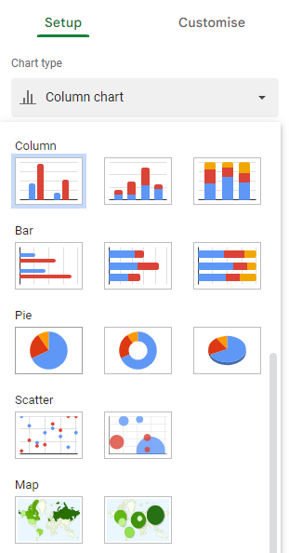
Constructing pie charts using spreadsheets
After selecting Insert chart, a diagram will instantly appear.
Whilst this is called Column chart in Google Sheets, we know it as a bar chart.
To change the diagram into a pie chart, go to the Chart editor, select Chart type, and find pie chart.
Google Sheets is a trademark of Google LLC and this content is not endorsed by or affiliated with Google in any way.

Slide 35
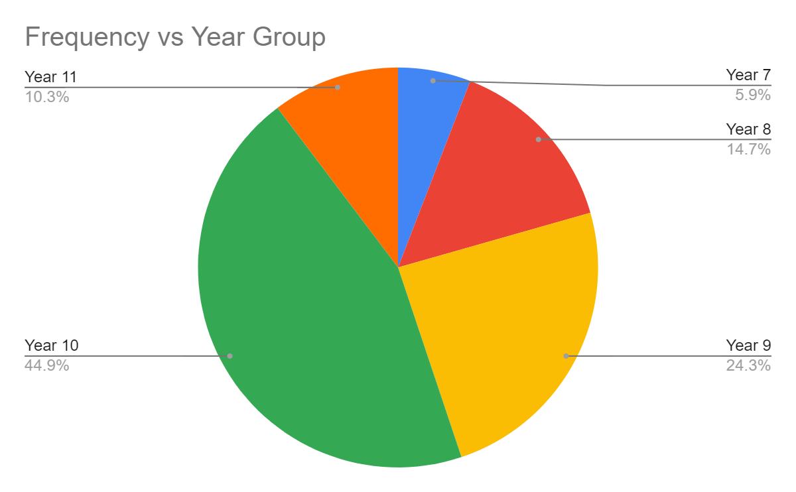
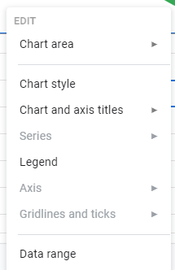
Constructing pie charts using spreadsheets
You should end up with a pie chart that looks like this.
You can right-click on the pie chart to change settings, such as:
style and colour
titles and labels
Google Sheets is a trademark of Google LLC and this content is not endorsed by or affiliated with Google in any way.

Slide 36
Constructing pie charts using spreadsheets
Click, hold, and drag to select the year groups and the frequencies.
Do not select the total frequency row or the angles column.
Year Group | Frequency | Angle
Year 7 | 8 | 21
Year 8 | 20 | 53
Year 9 | 33 | 87
Year 10 | 61 | 162
Year 11 | 14 | 37
Total Frequency | 136 | 360
In Microsoft Excel, go to the Insert tab.
There is a pie chart icon in the Charts section.

Slide 37

Constructing pie charts using spreadsheets
Which of these icons is the Insert chart icon?
a
b
c
d
e
f
Google Sheets is a trademark of Google LLC and this content is not endorsed by or affiliated with Google in any way.

Slide 38
Constructing pie charts using spreadsheets
You can also create the pie chart by plotting the angles, rather than the frequencies.
Year Group | Frequency | Angle
Year 7 | 8 | 21
Year 8 | 20 | 53
Year 9 | 33 | 87
Year 10 | 61 | 162
Year 11 | 14 | 37
Total Frequency | 136 | 360
To do this, click, hold, and drag the year group column (ignoring the total frequency row).
Then press and hold Ctrl on the keyboard.
Click, hold, and drag the angle column (ignoring the 360 on the bottom row).
Ctrl allows you to select the first and third columns, whilst ignoring the second.

Slide 39


Constructing pie charts using spreadsheets
Select the Insert chart icon and choose pie chart again.
What do you notice about the two pie charts you have made?
Can you explain why?
Both pie charts are exactly the same!
This is because the two pie charts are showing the same proportions based off of the same information: the first pie chart from frequencies, and the second pie chart from angles calculated off of those frequencies.
Google Sheets is a trademark of Google LLC and this content is not endorsed by or affiliated with Google in any way.

Slide 40
Constructing pie charts using spreadsheets
Put these instructions to create a pie chart from the angles (and not frequencies) in order.
a
Press and hold Ctrl on the keyboard
Car | Frequency | Angle
Diesel | 199 | 104.74
Petrol | 198 | 104.21
Electric | 95 | 50
Hybrid | 152 | 80
Hydrogen | 40 | 21.05
b
Click on the Select chart icon
c
Select pie chart
d
Click, hold, drag, the Car column
d
a
e
b
c
e
Click, hold, drag, the Angle column

Slide 41
Constructing pie charts using spreadsheets
Task B 🖇
Go to File → Make a copy to create your own copy to use
(you may also use the same document linked earlier in this lesson)
1) To practise creating pie charts, complete the questions on the sheet called Creating pie charts.
Google Sheets is a trademark of Google LLC and this content is not endorsed by or affiliated with Google in any way.

Slide 42
Constructing pie charts using spreadsheets
Task B Answers 🖇
The link will let you view all the answers to the practice tasks.
Google Sheets is a trademark of Google LLC and this content is not endorsed by or affiliated with Google in any way.

Slide 43
Constructing pie charts by utilising technology
In order to use spreadsheets for mathematical calculations, keyboard buttons for mathematical operations must be used (+, -, *, /, =).
Angles for a pie chart can be calculated using basic spreadsheet functions, such as the =sum( function.
Pie charts can be created easily in spreadsheet software using chart-creation facilities.

Slide 44

© Oak National Academy 2023.
Produced in partnership with Mathematics in Education and Industry.
Licensed on the Open Government Licence v3.0, except where otherwise stated. See Oak terms and conditions.

